Slide 1
Eigenvalues and eigenvectors: the directions a matrix only stretches
In a table with many columns, which directions do the data vary along most, and how do we look at embeddings with hundreds of numbers?
Mathematics for AI and Machine Learning | Session 5 of 18 | Linear algebra
KLAi Professional Learning | Jotham Martin Wambi
Notes:
Welcome to Session 5. Last time we solved systems and learned that a determinant of zero is a warning. Today we ask a gentler question about a matrix: are there directions it only stretches?
The answer turns out to describe where data varies most, and that is the idea behind principal component analysis, which we meet next session.
The question for today is this: In a table with many columns, which directions do the data vary along most, and how do we look at embeddings with hundreds of numbers? Keep it in mind. At the end of the session we come back to it and see how much more you can say.

Slide 2



Today in one view: what you will leave with
By the end of today you can
Say what an eigenvector and an eigenvalue are, with a picture of a matrix acting on a circle
Find the eigenvalues and eigenvectors of a 2 by 2 matrix by hand and check them with trace and determinant
Build a covariance matrix, find its top direction, and use power iteration to find it by repeated multiplying
Notes:
By the end of today you can say what an eigenvector and an eigenvalue are, using a picture of a matrix acting on a circle. You can find them by hand for a two by two matrix, and check them with the trace and the determinant. And you can build a covariance matrix from data, find the direction in which the data varies most, and find it again by repeated multiplication, called power iteration.
Which of those three sounds the hardest to you?

Slide 3
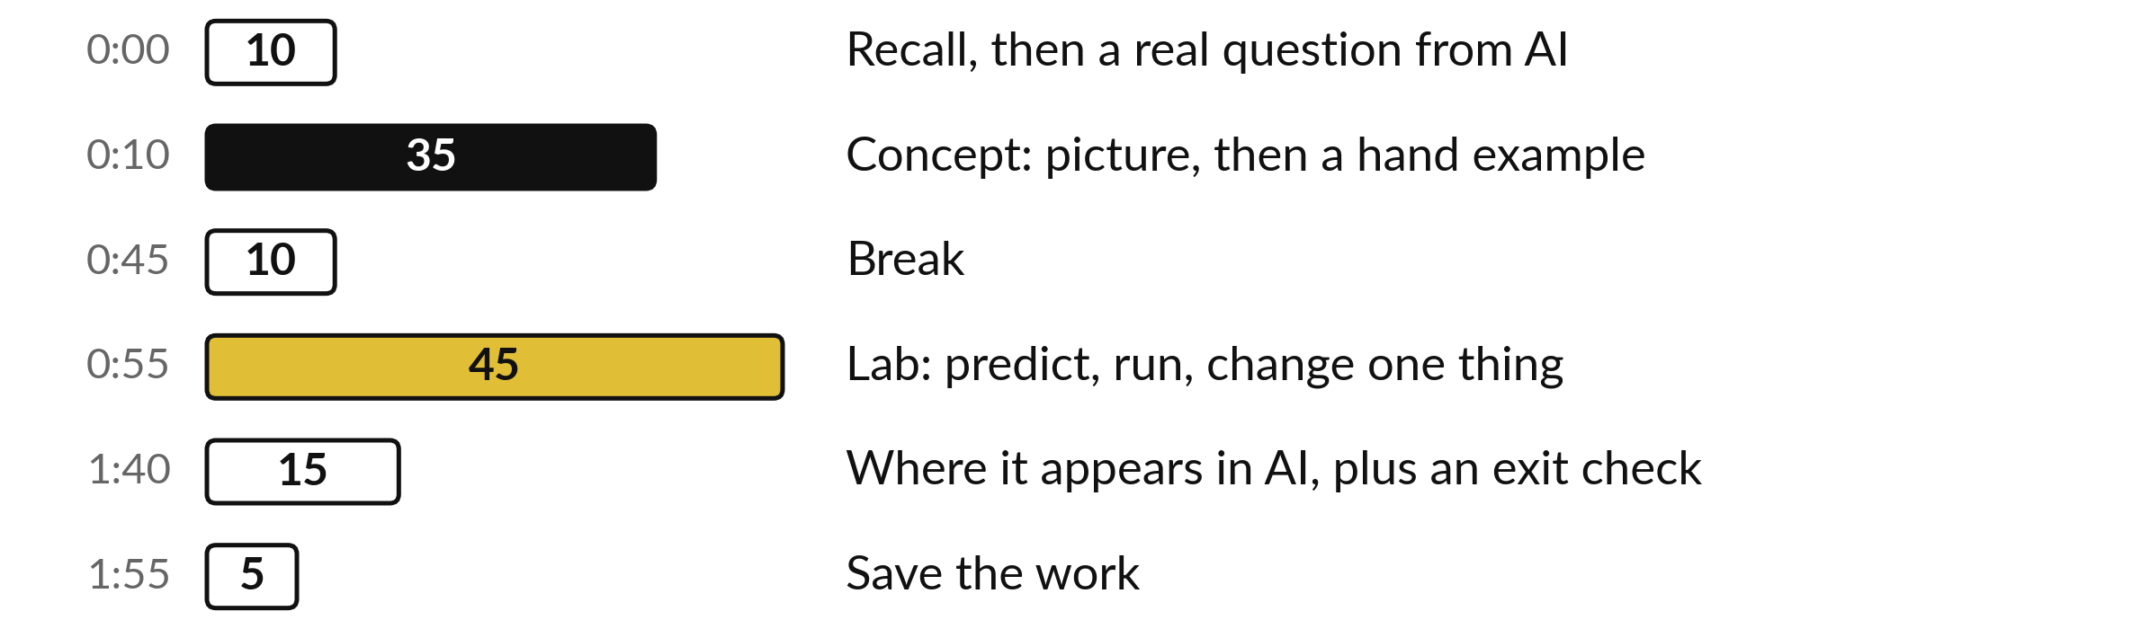
Your two hours: stretch directions, then data
Ideas first, with pictures. Then the lab in Python or in a spreadsheet. Then where it shows up in AI.
Notes:
We have two hours. Ten minutes to bring back Session 4 and set the question of the day. Thirty-five minutes of ideas, each as a picture and then a small calculation by hand. A ten minute break. Then forty-five minutes of lab, in Python or a spreadsheet, on the same numbers.
We end with where this appears in AI tools, an exit check, and five minutes to save.

Slide 4
Three questions from last time
1. What does a determinant of 0 tell you about a matrix?
2. Write the normal equation for fitting a line.
3. What is the rank of the matrix with rows (1, 2) and (2, 4)?
Answer aloud first. Then we check together.
Notes:
Three quick questions from Session 4. Answer aloud first, and then we check together. It is a warm-up to bring last time back.
Question one. What does a determinant of 0 tell you about a matrix? Take a moment.
A good answer is this. It squashes the plane onto a line or a point. It has no inverse and its rank is below full.
Question two. Write the normal equation for fitting a line. Say it to yourself first.
A good answer is this. XᵀX w = Xᵀy. It gives the weights w with the smallest squared error.
Question three. What is the rank of the matrix with rows (1, 2) and (2, 4)? Think about your own task as you answer.
A good answer is this. 1. The second column is twice the first, so the columns give only one direction.
If an answer was missing, do not worry. Your notes from last class have it. Now to today.

Slide 5
Answers to the three questions from Session 4
Question | Short answer
What does a determinant of 0 tell you about a matrix? | It squashes the plane onto a line or a point. It has no inverse and its rank is below full.
Write the normal equation for fitting a line. | XᵀX w = Xᵀy. It gives the weights w with the smallest squared error.
What is the rank of the matrix with rows (1, 2) and (2, 4)? | 1. The second column is twice the first, so the columns give only one direction.
If one surprised you, look back at Session 4 before the lab. Rank and determinant return today.
Notes:
A determinant of zero means the matrix squashes the plane onto a line or a point, so it has no inverse and its rank is below full. The normal equation is X transpose X times w equals X transpose y, and it gives the weights with the smallest squared error.
The matrix with rows one, two and two, four has rank one, because its second column is twice the first, so the columns give only a single direction. If one of these surprised you, look at Session 4 again before the lab.

Slide 6




Words we use today
Word | What it means
Eigenvector | A direction that a matrix only stretches, flips or squashes. It stays on its own line.
Eigenvalue | The factor by which an eigenvector is stretched. Written with the Greek letter lambda (λ).
Trace | The sum of the diagonal entries of a square matrix.
Covariance matrix | A table of how every pair of features varies together. The diagonal holds each feature's variance, the typical squared distance from its mean.
Power iteration | Multiplying by a matrix again and again to find its top eigenvector.
Notes:
Five words for today. I give the plain meaning of each, and we use every one of them before the end of the session.
Eigenvector. A direction that a matrix only stretches, flips or squashes. It stays on its own line.
Eigenvalue. The factor by which an eigenvector is stretched. Written with the Greek letter lambda (λ).
Trace. The sum of the diagonal entries of a square matrix.
Covariance matrix. A table of how every pair of features varies together. The diagonal holds each feature's variance, the typical squared distance from its mean.
Power iteration. Multiplying by a matrix again and again to find its top eigenvector.

Slide 7
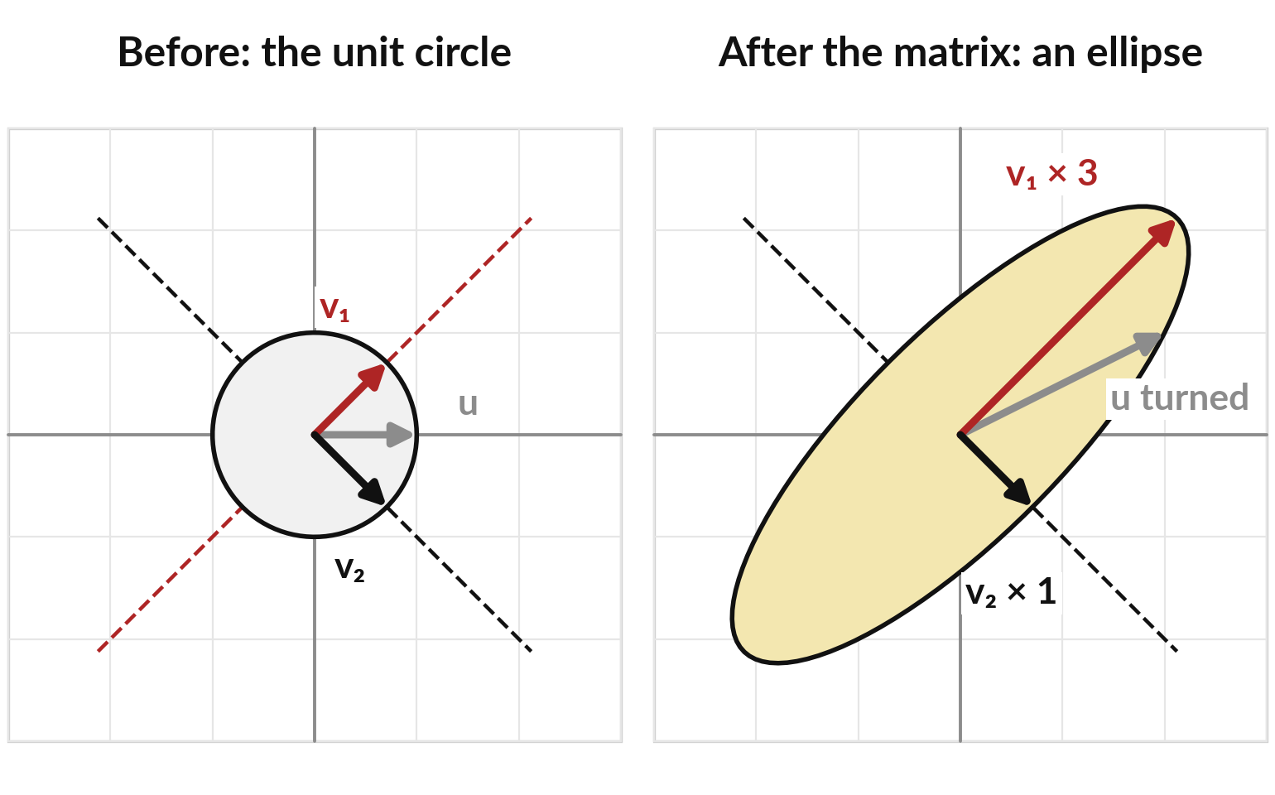
Most arrows turn when a matrix acts on
them, but a few directions only stretch
The matrix with rows (2, 1) and (1, 2) turns a circle into an ellipse. The grey arrow u turns.
v₁ points along (1, 1) and becomes 3 times longer.
v₂ points along (1, −1) and keeps its length.
Such directions are eigenvectors.
Notes:
Picture a matrix acting on every arrow that starts at the origin and has length one, the unit circle. Our matrix has rows two, one and one, two. It turns the circle into an ellipse. Most arrows, like the grey arrow u, get turned to a new direction.
But two special directions stay on their own lines. The red arrow v one, along one, one, becomes three times longer. The black arrow v two, along one, minus one, keeps its length. Those special directions are called eigenvectors. The ellipse is longest along one dashed line and shortest along the other, and that is no accident: the longest stretch happens along an eigenvector.

Slide 8

An eigenvector v and its
eigenvalue λ satisfy Av = λv
Symbol | What it means | In our data
A | A square matrix. Here the rows are (2, 1) and (1, 2). | 2 by 2
v | An eigenvector: a nonzero vector whose direction A keeps. | (1, 1) or (1, −1)
λ | The eigenvalue (Greek letter lambda): the factor by which A stretches v. | 3 for (1, 1), and 1 for (1, −1)
Av | Matrix times vector. For (1, 1): (2 + 1, 1 + 2). | (3, 3)
A negative λ flips v. A λ of 0 squashes it to the origin. Any multiple of v is an eigenvector too.
Notes:
The definition fits on one line: A times v equals lambda times v. It says: when A acts on v, the result is the same vector scaled by a number. That number lambda is the eigenvalue. For our matrix, take v equal to one, one. A times v gives two plus one, which is three, and one plus two, which is three.
So A v is three, three, which is three times v. The eigenvalue is three. Any multiple of v works as well, so we care about the direction. Check the table row by row, and say each symbol aloud.

Slide 9
Testing four arrows by hand:
only two directions survive
Arrow v | Av | Same line as v? | Stretch factor
(1, 0) | (2, 1) | No, it turned | none
(1, 1) | (3, 3) | Yes | 3
(1, -1) | (1, −1) | Yes | 1
(1, 2) | (4, 5) | No, it turned | none
A has rows (2, 1) and (1, 2). Compute Av with a dot product for each row: for (1, 2) it is 2 + 2 = 4 and 1 + 4 = 5.
Notes:
Try four arrows by hand. For one, zero, A v is two, one, a new direction, so it turned. For one, one we get three, three: same line, stretched by three. For one, minus one we get one, minus one: the same arrow, a stretch of one. For one, two we get four, five, which is not a multiple of one, two, so it turned.
Two directions survive. A two by two matrix has at most two different eigenvalues, and when the two eigenvalues differ, as here, there are two eigen-directions. A matrix like two times the identity keeps every direction, so do not say at most two directions.

Slide 10
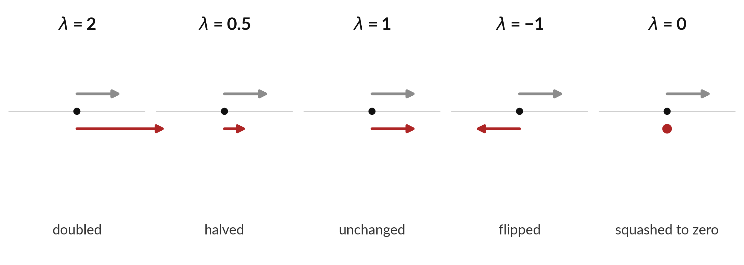
The eigenvalue says whether the arrow
is stretched, shrunk, flipped or squashed
Grey arrow: an eigenvector. Red arrow: what A turns it into. λ (lambda) is the multiplier.
Notes:
Reading an eigenvalue takes one look. The grey arrow is an eigenvector. The red arrow is what A turns it into, and lambda is the multiplier. Lambda two doubles the arrow. Lambda one half halves it. Lambda one leaves it alone. Lambda minus one flips it to the opposite direction, but keeps its length.
And lambda zero squashes it to nothing, which is the determinant zero case from last session. In fact the determinant is the product of the eigenvalues, as we will see shortly.

Slide 11
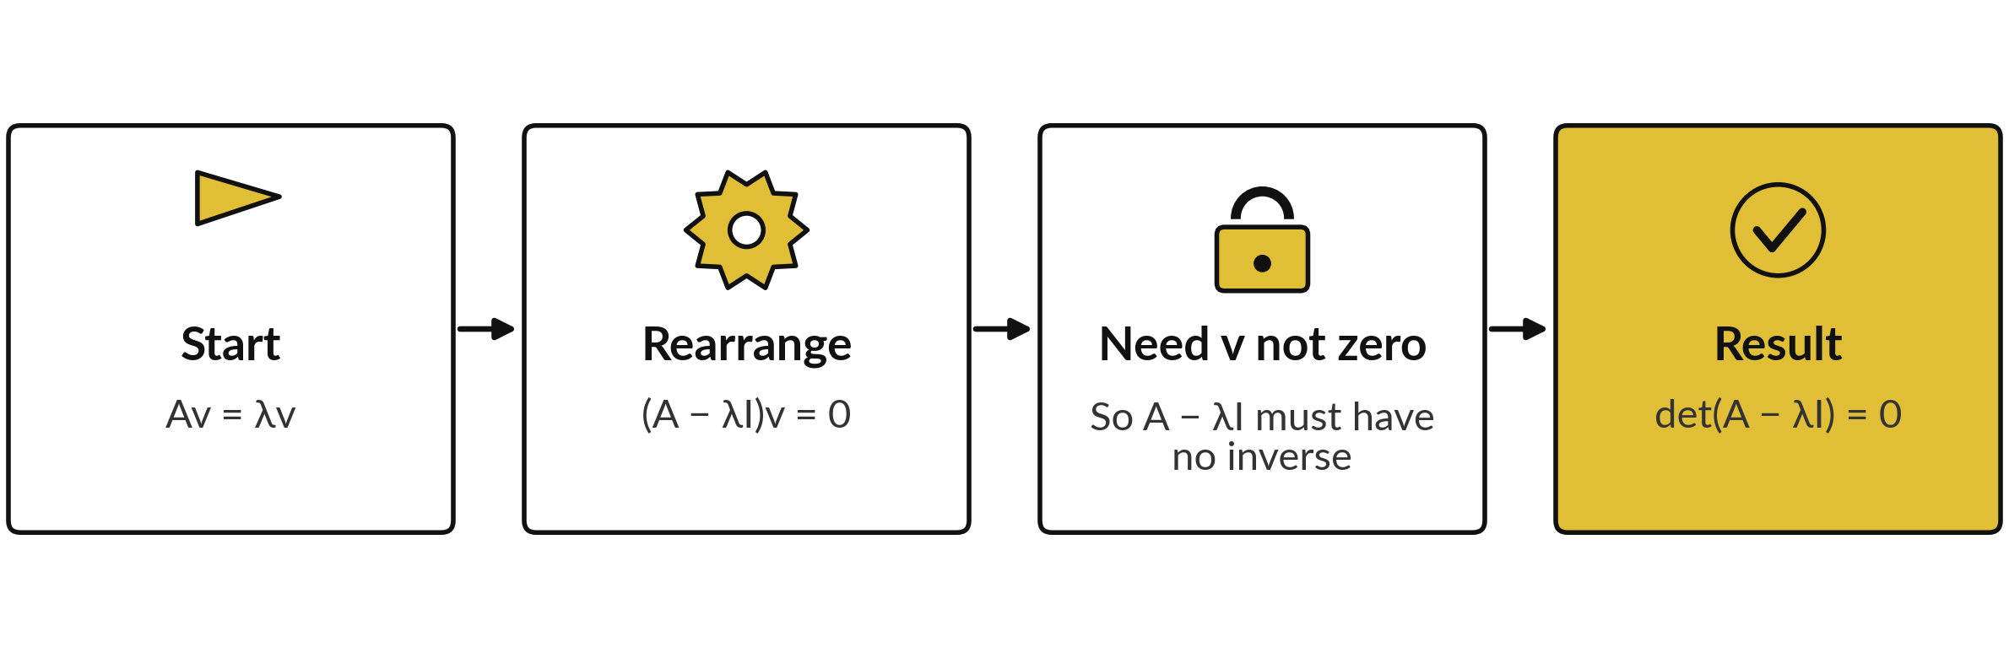
To find eigenvalues, ask
when A - λI has no inverse
λI has λ on the diagonal. If A − λI had an inverse, multiplying (A − λI)v = 0 by it would give v = 0. So no inverse: determinant 0 (Session 4).
Notes:
Finding the eigenvalues starts from the definition. Start with A v equals lambda v. Move everything to one side: A minus lambda I, times v, equals zero, where I is the identity matrix. We want a v that is not the zero vector. If A minus lambda I had an inverse, multiplying by it would force v to be zero.
So A minus lambda I must have no inverse, and from Session 4 that means its determinant is zero. The determinant of A minus lambda I equals zero is called the characteristic equation. The identity is there because we cannot subtract a number from a matrix: lambda I puts lambda on the diagonal.

Slide 12
Writing det(A - λI) = 0 out for our matrix
A has rows (2, 1) and (1, 2). We subtract λ from each diagonal entry and take the determinant.
A - λI
Rows (2 − λ, 1) and (1, 2 − λ).
Determinant
(2 − λ)(2 − λ) − 1 × 1 = 4 − 4λ + λ² − 1 = λ² − 4λ + 3.
Set it to 0
λ² − 4λ + 3 = (λ − 3)(λ − 1) = 0, so λ = 3 or λ = 1.
Any 2 by 2
The same steps give λ² − Tλ + D = 0, with T the sum of the diagonal and D the determinant.
Notes:
Write it out for our matrix. Subtract lambda from each diagonal entry. The rows become two minus lambda, one, and one, two minus lambda. The determinant is two minus lambda, times two minus lambda, minus one times one. Expand the brackets: four, minus four lambda, plus lambda squared, then minus one.
That tidies to lambda squared, minus four lambda, plus three. Set that to zero. It factors as lambda minus three, times lambda minus one, so lambda is three or one. These are the same eigenvalues we found by testing arrows. The last line says the same steps work for any two by two matrix, and the general form comes straight after this.

Slide 13
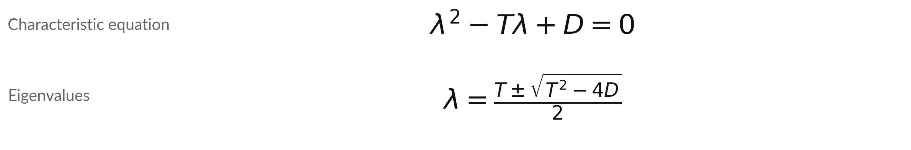
For any 2 by 2 matrix the
characteristic equation is a quadratic
Symbol | What it means | In our data
T | The trace: the sum of the diagonal entries, a₁₁ + a₂₂. | 2 + 2 = 4
D | The determinant: a₁₁a₂₂ − a₁₂a₂₁ (aᵢⱼ is row i, column j of A). | 2 × 2 − 1 × 1 = 3
± | Plus gives one eigenvalue, minus gives the other. | (4 + 2) / 2 and (4 − 2) / 2
λ | The two eigenvalues. | 3 and 1
Check: the eigenvalues add up to the trace (3 + 1 = 4) and multiply to the determinant (3 × 1 = 3).
Notes:
Expanding the determinant of A minus lambda I for any two by two matrix gives the quadratic you just saw: lambda squared, minus T lambda, plus D equals zero. T is the trace, the sum of the diagonal, a one one plus a two two, and D is the determinant, a one one times a two two, minus a one two times a two one.
The quadratic formula then gives lambda equals T plus or minus the square root of T squared minus four D, all over two. For our matrix T is four and D is three, so the square root is two and lambda is three or one. Notice the check at the bottom: the eigenvalues add to the trace and multiply to the determinant. In the spreadsheet you will type this formula into cells.

Slide 14
Worked example: eigenvalues
and eigenvectors of our matrix
A has rows (2, 1) and (1, 2). We find λ first, then an eigenvector (s, t) for each λ.
Eigenvalues
λ² − 4λ + 3 = 0. So λ = (4 + 2) / 2 = 3 or λ = (4 − 2) / 2 = 1.
For λ = 3
A − 3I has rows (−1, 1) and (1, −1). The equation −s + t = 0 gives s = t, so v₁ = (1, 1).
For λ = 1
A − I has rows (1, 1) and (1, 1). The equation s + t = 0 gives v₂ = (1, −1).
Check
A (1, 1) = (3, 3) and A (1, −1) = (1, −1). Both match.
Notes:
The whole recipe runs in three moves. The quadratic is lambda squared, minus four lambda, plus three, so lambda is three or one. We look for an eigenvector with entries s and t. For lambda three, subtract three from the diagonal, giving rows minus one, one and one, minus one.
Both rows say minus s plus t equals zero, so s equals t, and v one is one, one. For lambda one, subtract one from the diagonal, giving rows one, one and one, one, so s plus t is zero, and v two is one, minus one. The last line checks both by multiplying.
The two rows are multiples of each other every time, because A minus lambda I has no inverse at an eigenvalue. That was the whole point of the last two slides.

Slide 15
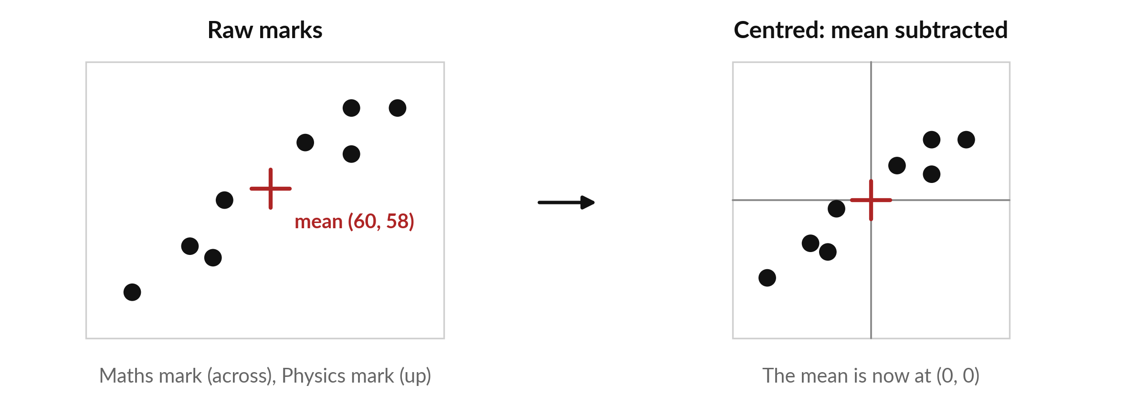
Centring: subtract each feature's
mean so the cloud sits on the origin
Eight students (illustrative). Mean maths 60, mean physics 58. Each mark minus its mean.
Notes:
Real data next. Eight students, each with a maths mark and a physics mark, invented to show the arithmetic. The left picture shows the raw marks, with the mean of maths at 60 and the mean of physics at 58. The first step of almost every method in this part of the course is centring: subtract each feature's mean from its column.
The shape of the cloud does not change, but now its centre sits at the origin. The cloud runs from bottom left to top right, which says high maths marks go with high physics marks. The next slides turn that tilt into numbers.

Slide 16
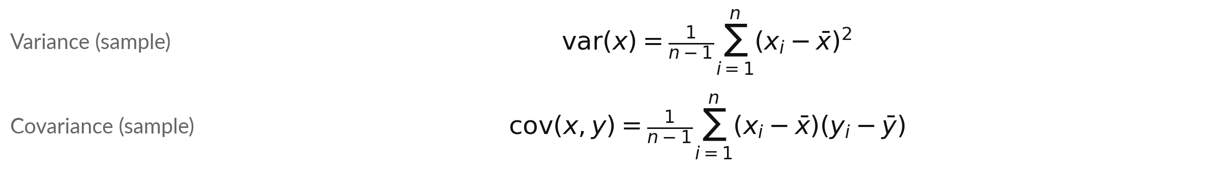
Mean, variance and covariance measure
the centre, the spread and the tilt
Symbol | What it means | In our data
n, xᵢ, yᵢ | n students; xᵢ and yᵢ are the marks of student i. Σ adds them up. | 8 students
x̄ (x-bar) | The mean: (x₁ + ... + xₙ) / n. Later sessions also write it μ. | 60 and 58
var, cov | Variance: typical squared distance from the mean. Covariance: positive when both rise together. | 66, 38; 48
n - 1 | Distances to a mean taken from the same data come out a little small; n − 1 corrects that. | divide by 7
Sample version: np.cov, VAR.S, COVARIANCE.S. Dividing by n gives 57.75, 33.25, 42. Session 13 returns to this.
Notes:
Three short formulas describe a cloud of data. The mean is the centre: add the values and divide by n. The variance is the spread: square each distance from the mean, add, and divide by n minus one. The covariance is the tilt: multiply the two distances for each student, add, and divide by n minus one.
It is positive when the two marks rise together. Why n minus one?
The mean was worked out from the same eight marks, so the data sit a little closer to it than to the true centre, and the squared distances come out a little small. Dividing by n minus one corrects that. This is called the sample version, and it is what numpy and the dot S spreadsheet functions use. Session 13 returns to it.

Slide 17
Worked by hand: the covariance
matrix of the eight marks
Illustrative marks. Centred = mark minus its mean. In matrix form C = Xcᵀ Xc / (n − 1), with Xc the centred marks.
Maths marks
53, 55, 63, 67, 48, 67, 56, 71. Mean 60. Centred: −7, −5, 3, 7, −12, 7, −4, 11.
Physics marks
53, 52, 62, 65, 49, 61, 57, 65. Mean 58. Centred: −5, −6, 4, 7, −9, 3, −1, 7.
Sums
Squared centred maths marks add to 462, physics to 266. Maths times physics: 336.
Divide
Divide by n − 1 = 7. Variances 66 and 38. Covariance 48. So C has rows (66, 48) and (48, 38).
Notes:
Do it once by hand. The mean of the maths marks is 60 and the mean of the physics marks is 58. Subtract each mean from its column, giving the two lists of centred values. Square each centred maths value and add: 462. Do the same for physics: 266.
Multiply each pair and add: 336. Divide each by seven, which is n minus one. The variances are 66 and 38, and the covariance is 48. Arranged in a table, these give the covariance matrix C, with variances on the diagonal and the covariance off it. C is symmetric, and its positive covariance matches the tilt we saw in the picture.

Slide 18
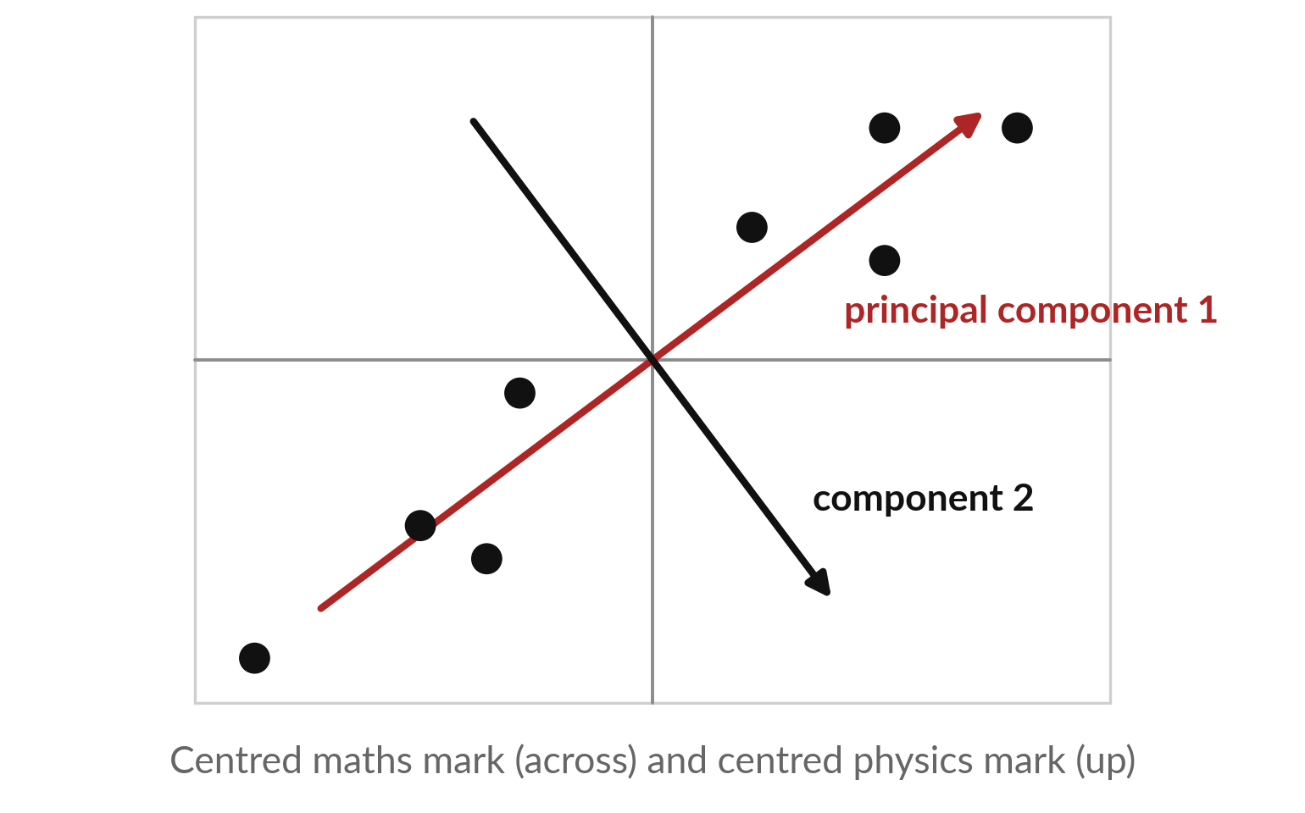
The eigenvectors of the covariance
matrix are the directions of the cloud
Centred students. Red: the top eigenvector v₁ of C. Black: v₂.
v₁ = (0.8, 0.6), variance 102: the direction of greatest spread, called the first principal component (Session 6).
v₂ = (0.6, −0.8): variance 2.
Each eigenvalue is the variance along its eigenvector.
Notes:
This is the payoff. Draw the centred students, and draw the eigenvectors of their covariance matrix. The red arrow, v one, points along the long axis of the cloud. That is the direction in which the data vary most, and it has a name: the first principal component.
Principal component analysis, next session, is built on it. The black arrow, v two, is at right angles, along the short axis, where the dots barely spread. For an eigenvector of length one, the eigenvalue tells you how much spread: along the red direction the variance is 102, and along the black one only 2.
So the eigenvectors of the covariance matrix are the natural axes of the data.

Slide 19
Worked by hand: eigenvalues
and top eigenvector of C
C has rows (66, 48) and (48, 38). We use the 2 by 2 formulas from earlier.
Trace and determinant
T = 66 + 38 = 104. D = 66 × 38 − 48 × 48 = 204.
Eigenvalues
The square root of 104² − 4 × 204 is 100. So λ = (104 + 100) / 2 = 102 or (104 − 100) / 2 = 2.
Top eigenvector
C − 102I has rows (−36, 48) and (48, −64). So −36s + 48t = 0, which gives t = 0.75s. Take (4, 3). Length 5, so v₁ = (0.8, 0.6).
Share of variance
102 / 104 = 98.1 percent of all the variance lies along direction 1.
Notes:
The same recipe works on the covariance matrix. Trace 104, determinant 204. The square root part is the square root of 10000, which is 100. So the eigenvalues are 102 and 2. For the top eigenvector, subtract one hundred two from the diagonal. The first row says minus thirty-six s plus forty-eight t equals zero, so t is three quarters of s.
Take four, three, and divide by its length five to get zero point eight, zero point six. Finally one hundred two out of one hundred four is 98.1 percent. Almost all the spread of the eight students lies along one direction.

Slide 20

Power iteration finds the top
eigenvector by repeated multiplying
Symbol | What it means | In our data
gₖ | The guess after k steps. Almost any start works. | g₀ = (1, 0) here
Agₖ | Multiply the guess by the matrix. | one matrix times vector product
max |.| | The entry with the largest size. Dividing by it keeps numbers small. | gₖ has largest entry 1
λ | Top eigenvalue: max|Agₖ| estimates it because gₖ has largest entry 1. | estimate tends to 3
It works when one eigenvalue is largest in size. When the top two are nearly equal in size, it converges slowly.
Notes:
Power iteration is the simplest way to find the top eigenvector by computer, and it only needs matrix times vector. Start with any guess, called g zero. Multiply it by A. Divide the result by its largest entry so the numbers do not grow. Repeat. Each multiplication stretches the top direction a little more than the others, so after a few rounds the top direction wins.
Because the guess always has largest entry one, the largest entry after multiplying estimates the eigenvalue. It needs one eigenvalue that is clearly the largest in size. That is usually the case for covariance matrices, and when the top two are nearly equal it is slow.

Slide 21
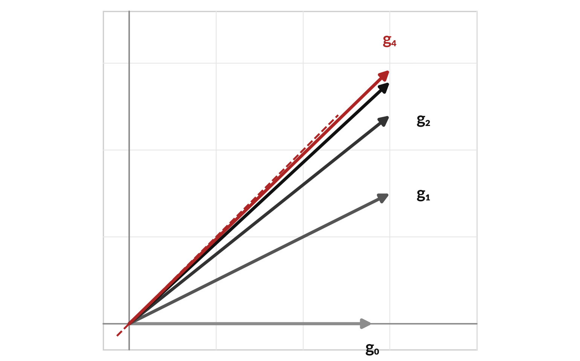
Each multiplication swings the arrow
closer to the top eigen-direction
Matrix with rows (2, 1) and (1, 2). Start at g₀ = (1, 0). Multiply, then divide by the largest entry.
g₁ = (1, 0.50), g₂ = (1, 0.80), g₄ is almost (1, 1).
The estimates of λ are 2.00, 2.50, 2.80, 2.93, 2.98. They head to 3.
Notes:
Watch it happen on the small matrix. Start at the arrow g zero, one, zero. Multiplying by A gives two, one. Divide by two: g one is one, and one half. Multiply again: two point five, two. Divide: g two is one, point eight. The arrows swing towards the one, one direction, which is the eigenvector for lambda three.
The estimates of the eigenvalue, the largest entries before dividing, are 2.00, 2.50, 2.80, 2.93, 2.98, heading to three. The first step moves the arrow most, because that is when the unwanted direction is largest. After a handful of steps the arrow is almost on the dashed line.

Slide 22
Power iteration by hand
on the covariance matrix C
Step k | Guess gₖ | C gₖ | Largest entry
0 | (0.000, 1.000) | (48.0, 38.0) | 48.00
1 | (1.000, 0.792) | (104.0, 78.1) | 104.00
2 | (1.000, 0.751) | (102.0, 76.5) | 102.04
3 | (1.000, 0.750) | (102.0, 76.5) | 102.00
4 | (1.000, 0.750) | (102.0, 76.5) | 102.00
5 | (1.000, 0.750) | (102.0, 76.5) | 102.00
This time the start is g₀ = (0, 1), to show that any start works. After 6 multiplications (row k = 5) the estimate is 102.0, close to 102, and the guess is near (1, 0.75), which is (0.8, 0.6) at length 1.
Notes:
Power iteration on the covariance matrix starts somewhere else on purpose, at g zero equal to zero, one, to show that the start does not matter. Multiplying by C gives forty-eight, thirty-eight, and we divide by forty-eight. The next guess is one, point seven nine. Multiply again, divide again, and by step three the guess is already very close to one, point seven five.
The largest entry, our estimate of the eigenvalue, settles near one hundred two. The second eigenvalue is only two, so each step shrinks the unwanted part by a factor of about fifty, and convergence is fast. In the spreadsheet you will build this table in rows of cells.

Slide 23

Four things people get wrong about eigenvectors
Mistake | What is true | What to do
Treating an eigenvector as one fixed arrow | Any multiple, and the opposite arrow, is also an eigenvector. | Quote a unit-length version. Expect sign flips between tools.
Looking for eigenvalues of a non-square matrix | Only square matrices have them. | Use the SVD for other shapes (Session 6).
Expecting real eigenvalues always | A quarter-turn rotation has no real eigenvalues, because every arrow turns. | Covariance matrices are symmetric and always give real ones.
Mixing up the two outputs | For a covariance matrix, the eigenvalue is the spread along its eigenvector. | Quote both together.
Notes:
Four things to remember. First, an eigenvector is a direction, and any multiple of it works, including the opposite arrow. So two tools can give the same eigenvector with opposite signs, and both are right. Second, eigenvalues belong to square matrices only. For other shapes we use the singular value decomposition next session.
Third, a quarter-turn rotation has no real eigenvalues, because every arrow turns. Covariance matrices are symmetric, which guarantees real eigenvalues. Fourth, keep the roles straight: for a covariance matrix the eigenvalue is how much spread, the eigenvector is which direction.

Slide 24
Centre, divide by n - 1, then eigh:
the covariance route in five lines
In plain words
Xc = X - X.mean(axis=0)
C = Xc.T @ Xc / (len(X) - 1)
values, vectors = np.linalg.eigh(C)
g = np.array([0.0, 1.0])
for k in range(6):
Cg = C @ g
est = np.max(np.abs(Cg))
g = Cg / est
Xc = ... centres each column by subtracting its mean.
C = ... is the covariance matrix, dividing by n − 1 (the same as np.cov(X.T)).
eigh is for symmetric matrices. It lists eigenvalues from smallest to largest, with eigenvectors in the columns.
The loop from g = ... is power iteration. est holds the eigenvalue estimate.
Notes:
The code follows the slides line by line. Subtract the column means to centre. Form the covariance matrix with X c transpose times X c over n minus one, which is what np dot cov gives too. Then np dot linalg dot eigh returns the eigenvalues and the eigenvectors.
The letters e, i, g, h are for symmetric matrices, which covariance matrices always are. It lists the eigenvalues from smallest to largest, and the eigenvectors are the columns. Below is power iteration in a short loop: multiply, find the largest entry, divide. You do not need to memorise it, since the notebook explains every line.

Slide 25
Part 2: the lab
Close the slides. Open the notebook or the workbook.
Notes:
That is the end of the ideas. In the lab you compute eigenvalues three ways: by the formula, with a library, and by power iteration. Choose the Python notebook or the spreadsheet workbook. The numbers are identical in both, and each step ends with an automatic check. A spreadsheet has no eigenvalue function in Excel or Google Sheets, so there you build the formula and the iteration rows yourself.
Predict, run, read, then change one thing. Raise your hand when a check stays red.

Slide 26
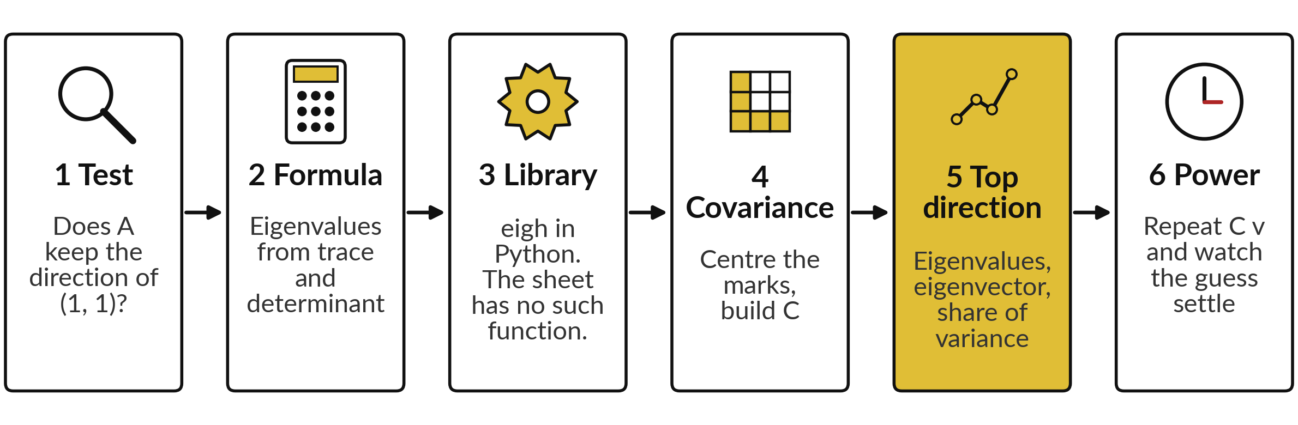
Six lab steps: one arrow, two formulas,
then the marks of eight students
Python uses numpy. The spreadsheet uses MMULT, VAR.S, COVARIANCE.S, SQRT and rows of cells. Gold cells are yours.
Notes:
The map has six steps. Step one, test whether A keeps the direction of one, one. Step two, find the eigenvalues from trace and determinant. Step three, Python only: check with a library function. The spreadsheet has none, so the formula is the tool. Step four, centre the eight marks and build the covariance matrix.
Step five, find its eigenvalues, the top eigenvector and the share of variance. Step six, power iteration in rows of cells. Predict each answer before you look.

Slide 27







Check your lab against 3 and
1, then C, then 102 and 2
What you compute | You should see
A times (1, 1) for the small matrix | (3, 3)
Eigenvalues of the small matrix | 3 and 1
Covariance matrix C of the eight marks (divide by n − 1) | rows (66, 48) and (48, 38)
Eigenvalues of C | 102 and 2
Top eigenvector of C, unit length | (0.8, 0.6)
Share of variance along direction 1 | 0.981
Power iteration after 6 multiplications (row k = 5): largest entry | 102.0
Covariance if physics is replaced by 100 minus physics | −48: the sign flips, the size stays
If a number differs, stop and find the step that went wrong. The sign of an eigenvector may differ between tools.
Notes:
Use this as your checkpoint. If your numbers match, carry on. If they do not, stop and call me over. The usual causes are dividing by n instead of n minus one, forgetting to centre, and mixing up the order of the two features. An eigenvector may come out with the opposite sign in a different tool, and that is fine.
The notebook checks the absolute values for that reason. Please do not type a number just to make a check pass.

Slide 28



Minus signs, ordering and centring
explain most lab surprises
Error or symptom | What it says | What to do
The eigenvector has a minus sign | The opposite arrow is also an eigenvector. | Compare absolute values, or flip the sign.
Eigenvalues come out in the wrong order | eigh lists smallest first. | Reverse the list or sort it.
Covariance far too large | The data were not centred first. | Subtract the column means.
#NUM! in the spreadsheet | The square root of a negative number. | Check T² − 4D. For covariance it is never negative.
Notes:
Four things will happen to someone in the room. A minus sign on an eigenvector is not an error, because the opposite arrow is also an eigenvector. If the eigenvalues come out in the wrong order, remember that eigh lists the smallest first. If your covariance is far too big, you did not centre the data.
And a number error in the spreadsheet means a negative number under the square root, so check T squared minus four D. Read the last line of any message first.

Slide 29
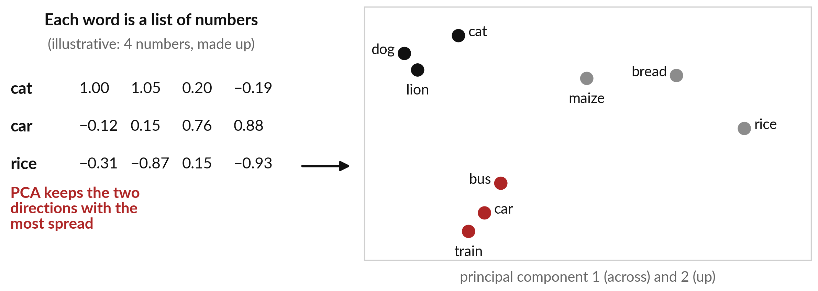
Where this appears in AI: PCA turns
embeddings into a map you can look at
PCA (principal component analysis) of made-up 4-number vectors. Real embeddings are far longer.
Notes:
Language models of this kind turn words and passages into embeddings, which are lists of numbers. To look at them, people project them down to two directions. The method is principal component analysis, or PCA, and it is the one you just learned: centre the vectors, form the covariance matrix, take the two eigenvectors with the largest eigenvalues, and plot each vector's position along them.
On the right, three clusters appear, animals, vehicles and foods. The vectors here are made up to show the idea, with four numbers each. Real embeddings are much longer, but the mathematics is the same.

Slide 30


Where this appears in AI:
looking at what models learn
PCA keeps the top eigenvectors of the covariance matrix of the data.
The Embedding Projector, published by Google researchers in 2016, offers PCA to view embeddings.
Open-weight models such as Llama publish their weights, so this analysis can be run on them.
Closed assistants do not publish their internal embedding tables. The vectors a public embedding service returns for your own text can be projected the same way.
Notes:
Three facts about where this shows up. First, principal component analysis is the top eigenvectors of the covariance matrix, which you have now computed by hand. Second, published tools such as the Embedding Projector, described by Google researchers in 2016, offer PCA to look at embeddings in two or three dimensions.
Third, open-weight models such as Llama publish their weights, so anyone can run this analysis on them. The internal embedding tables of closed assistants are not published, so we cannot draw them. But the vectors that a public embedding service returns for your own text can be projected in the same way.

Slide 31
Where this appears in AI: ask an assistant
for eigenvalues you already know
8 minutes
Hands-on, with any AI assistant
Ask an assistant for eigenvalues, then check them.
You keep
A note of which answers matched, and any sign differences.
Ask for the eigenvalues and eigenvectors of the matrix with rows (2, 1) and (1, 2). Expect 3 and 1.
Ask again for the covariance matrix with rows (66, 48) and (48, 38). Expect 102 and 2.
Ask it to show the characteristic equation. Never paste confidential data.
Notes:
A short activity. Open any assistant you use and ask it for the eigenvalues and eigenvectors of the small matrix, then of the covariance matrix with rows sixty-six, forty-eight and forty-eight, thirty-eight. You know the answers: three and one, and one hundred two and two. Ask it to show its characteristic equation, and read it for mistakes.
Assistants can slip on arithmetic, and checking against your own numbers is the skill. Never paste confidential company data. What differed from your answers?

Slide 32
Exit check: Av = λv, two eigenvalues,
and the top direction of data
Question | Short answer
What does Av = λv say in words? | A only stretches, flips or squashes the vector v. λ is the factor.
What are the eigenvalues of the matrix with rows (2, 1) and (1, 2)? | T = 4 and D = 3, so λ = 3 and 1.
What does the top eigenvector of a covariance matrix tell you? | The direction in which the data vary most. Its eigenvalue is the variance there.
Write your own answer first, then compare. Your lab checks are part of the exit check.
Notes:
Three questions to finish. What does A v equals lambda v say?
A only stretches, flips or squashes v, and lambda is the factor. What are the eigenvalues of the matrix with rows two, one and one, two?
The trace is four and the determinant is three, so three and one. And what does the top eigenvector of a covariance matrix tell you?
The direction in which the data vary most, with the eigenvalue as the variance there. Answer in your own words first.

Slide 33
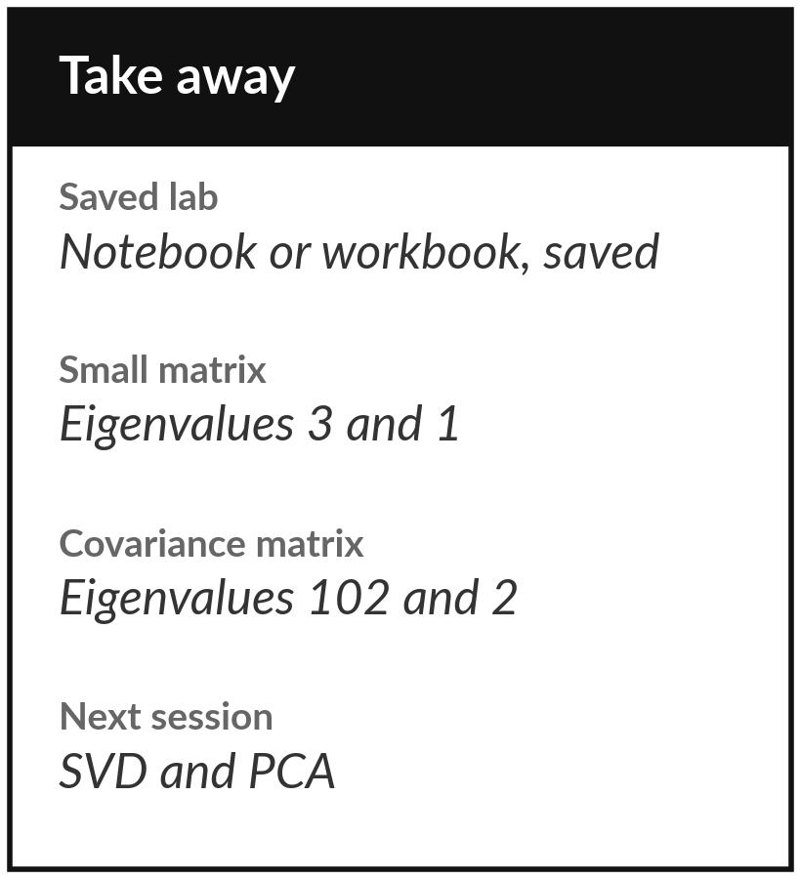
Save the lab and keep the four eigenvalues
What you keep from today
Keep the saved lab and four numbers: eigenvalues 3 and 1 for the small matrix, and 102 and 2 for the covariance matrix of the eight marks.
Our question today
In a table with many columns, which directions do the data vary along most, and how do we look at embeddings with hundreds of numbers?
Next session
Session 6: singular value decomposition and PCA, which build on today.
Notes:
Before you go, save your work with all checks green. Keep four numbers: eigenvalues three and one for the small matrix, and one hundred two and two for the covariance matrix of the eight marks. Next session we break any matrix into rotate, stretch, rotate, and we use the covariance matrix you built today to reduce two dimensions to one. Write down any question for next time.
We began with this question: In a table with many columns, which directions do the data vary along most, and how do we look at embeddings with hundreds of numbers? Before you go, say in one sentence what you can now say about it.

